Slide 1
The Study of 6LoWPAN with SCTP Multi-homing in Smart Grid
Yang-Wen Chen, Arak Sae Yuan, Kuan-Ta Lu and Quincy Wu
Department of Computer Science and Information Engineering,
National Chi Nan University,
Nantou, Taiwan

Slide 2
Outline
Background
Motivation
Network Layer Protocol
Transport Layer Protocol
System Architecture
Component – LKSCTP Protocol Stack
Component – Atmel RZRAVEN USB Dongle
Multi-homing Experiments
Performance Analysis
Conclusion

Slide 3
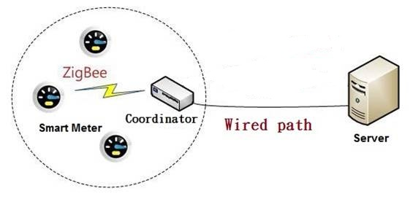
Background
Zigbee[3]
Based on IEEE 802.15 standard
Low-cost, low-power
Wireless mesh network
Feature(s) | Zigbee | 6LoWPAN
Addressing mode | Stochastic Addressing | SLAAC (StateLess Address AutoConfiguration)
Number of address | 2¹⁶ NWK address | 2¹²⁸ IP address
Integration with current Internet (TCP/IP network) | ZigBee/IP translator is required | No translator is required
Notes:
Wi-Fi有不錯的有效範圍及傳輸率，可以使用在大部份的無線網路場合，但是在可攜式裝置上，它的耗電量可能相當大。
藍芽的耗電量相當小，一般認為適合作為手機等一類裝置的網路裝置。
ZigBee雖然傳輸速率都沒有上述兩者好，但低耗電和mesh網路等特色，因此被定位在收發少量的資料量的應用。

Slide 4
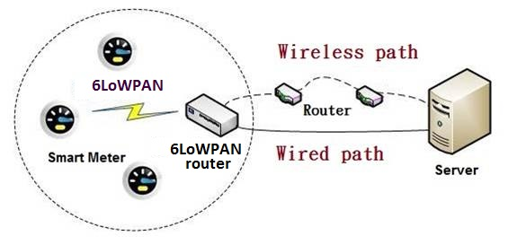
Motivation
Build a multi-homing smart grid system in our campus
Upon the failure of a single network interface, the device can switch to other network interface to continue its communication

Slide 5
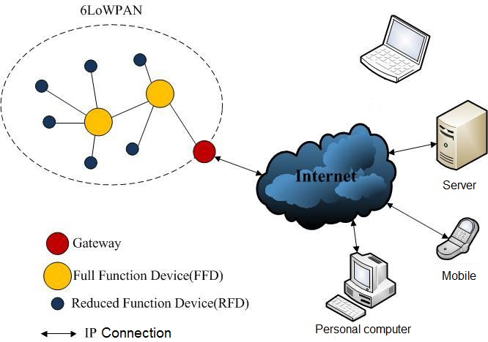
Network Layer Protocol
6LoWPAN (IPv6 over Low Power Wireless Personal Area Networks)[4][5]
IPv6-based low-power wireless
Proposed by IETF working group applied in smart grid
Easily integrated with IP network
Notes:
當 6LoWPAN 網路內的精簡功能設備欲傳送訊息給網路外之 IP 設備時，首先必須將封包傳送給上層全功能設備，然後全功能設備會透過路由機制一層一層的將封包送給 6LoWPAN 閘道器(Gateway)。6LoWPAN 閘道器與 IPv6 網域相連接，經過封包底層的轉換，則可以使用 IP 位址將封包正確傳送到達目的地。

Slide 6
Transport Layer Protocol
Overview of SCTP(Stream Control Transmission Protocol)
Multi-homing
TCP connection is one-to-one between two network interfaces
SCTP association is many-to-many between multiple network interfaces
Notes:
支援 SCTP 的兩端點可以藉由關聯建立多條路徑，圖中主機 A 與主機 B 各有兩個 IP 位址，即表示有兩個傳輸介面，而傳送端會選定一條路徑作為傳輸的主要路徑，當傳輸過程發生封包遺失時，則會選擇其中一條備援路徑重送封包；如果主要路徑發生斷線或是故障的情況，傳送端會從備援路徑中選擇一條作為新的主要路徑。透過多重定址的機制，可以達到錯誤時快速復原的功能，增強網路服務的健壯性(Robustness)，也就是經由路徑之間的切換，進而提高網路的容錯能力。
有別以往TCP 在傳輸實際資料前需要在兩端點間建立一條連線(connection)，SCTP 改用更廣義的關聯
(association)概念，即兩端點間連線不再只是單一通道，中間傳輸可以有多組IP
位址或是多條的資料流，透過關聯讓兩端點能夠相互的傳輸，藉此達到所謂的多
重定址(Multi-homing)
TCP multihomed server http://www.tcpipguide.com/free/t_NumberofIPAddressesandMultihoming.htm

Slide 7
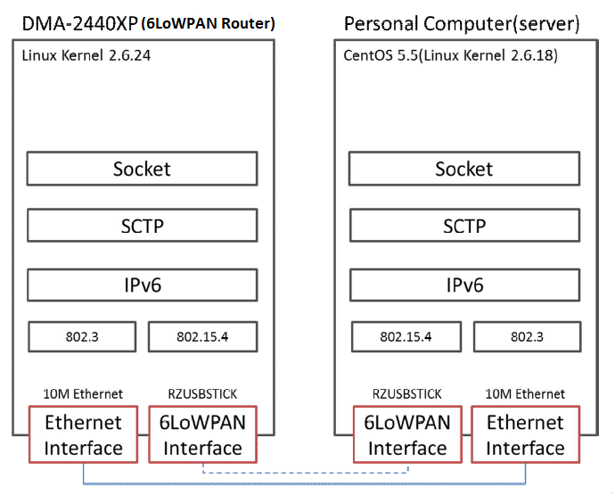
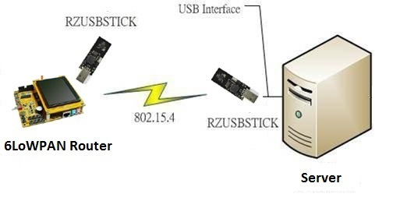
System architecture
Notes:
支援 SCTP 的兩端點可以藉由關聯建立多條路徑，圖中主機 A 與主機 B 各有兩個 IP 位址，即表示有兩個傳輸介面，而傳送端會選定一條路徑作為傳輸的主要路徑，當傳輸過程發生封包遺失時，則會選擇其中一條備援路徑重送封包；如果主要路徑發生斷線或是故障的情況，傳送端會從備援路徑中選擇一條作為新的主要路徑。透過多重定址的機制，可以達到錯誤時快速復原的功能，增強網路服務的健壯性(Robustness)，也就是經由路徑之間的切換，進而提高網路的容錯能力。

Slide 8
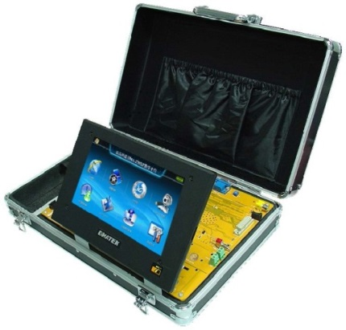
Component – LKSCTP Protocol Stack
DMA-2440XP Platform Porting
DMA-2440XP platform running Linux 2.6
Through the cross-platform development process.
The SCTP protocol stack adopted is LKSCTP(Linux Kernel Stream Control Transmission Protocol)
Cramfs file system was created by the busybox-1.11.1 tool

Slide 9
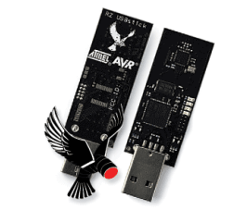
Component – Atmel RZRAVEN USB Dongle
Atmel RZRAVEN Development Board Porting
Install Contiki, and then cross-compile(avr-gcc) it to generate binary code.
Compile the RZUSBSTICK module
Through the JTAGICE mkII, the binary code can be uploaded to the AT90USB1287 microcontroller.

Slide 10
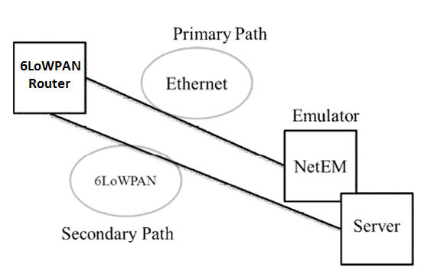
Multi-homing Experiments
SCTP Multi-homing Experiment
Over Ethernet only(Single-homing)
Over both Ethernet and 6LoWPAN interfaces (Multi-homing)
Notes:
SCTP 單一乙太網路路徑傳送，包含頻寬限制、封包遺失與延遲
SCTP 多重路徑傳送，同樣的，在乙太網路環境下，包含頻寬限制、封包遺失與延遲

Slide 11
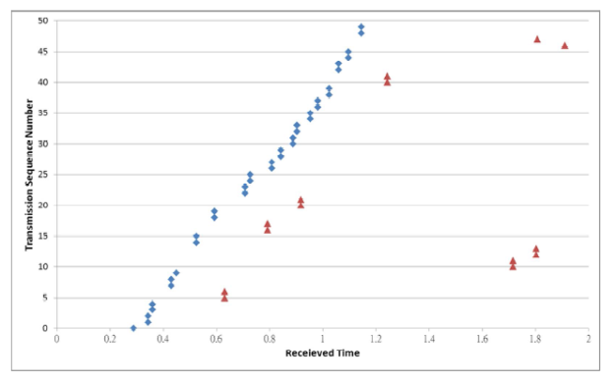
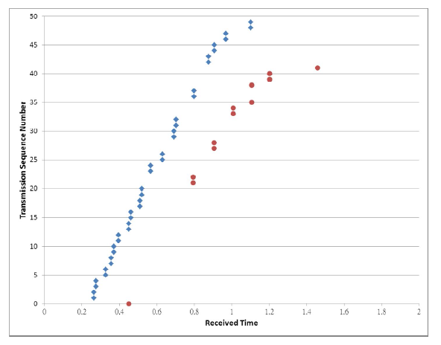
Performance Analysis
Data Measurement and Analysis
Single-homing Transmission (blue: normal transmission packets; red: retransmission packets)
Multi-homing Transmission (blue: normal transmission packets; red: retransmission packets)

Slide 12
Performance Analysis
 | Single-homing | Multi-homing
Packets | 588 | 576
Duration (second) | 33.457 | 26.084
Avg. packets/sec | 17.575 | 22.083
Avg. packet size (bytes) | 534.177 | 547.09
Avg. bytes/sec | 9388.05 | 12081.123
Avg. Mbits/sec | 0.075 | 0.097
Notes:
TCP header size 20 bytes
SCTP header size 36 bytes
Overhead 16 bytes, then 6LoWPEAN packet size is 128 bit.

Slide 13
Conclusion
It will be applied to a Smart Grid system to deliver data through the SCTP protocol.
increase the data transmission efficiency
reduce packet retransmission
In the future we may adopt Weighted Round Robin-Arrival Rate Dependent (WRR-ARD) algorithm to further improve the transmission performance

